Slide 1







Puppy master
DATA SCIENCE II / TU DARMSTADT
DeadLock

Slide 2
Contents
1 Overview
4 UI Design & Project structure
2 Data collection and augmentation
5 Demo
3 Model
6 Q&A

Slide 3


Team STRUCTURE
Johannes Wowra
Supervisor
DATA COLLECTION
MODEL TRAINGING
UI IMPLEMENTATION
DATA AUGMENTATION
MODEL EVALUATION
PROJECT IMPLEMENTATION
Jian Jiang
Haoyue Zhu
Keren Zhou
Ruize Xia
Xiaoyan Xue

Slide 4

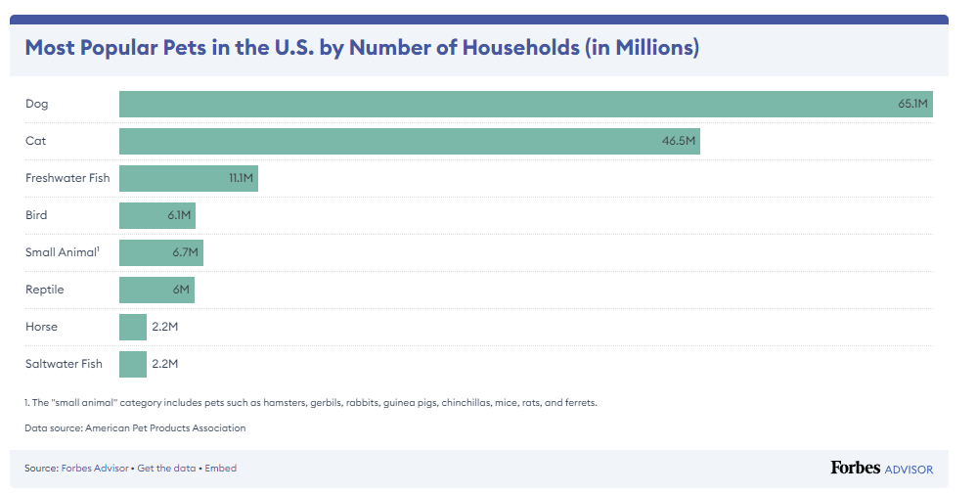
Project overview
DOGS: MOST POPULAR PETS
Dogs are the most popular pet in the U.S. (65.1 million U.S. households own a dog)
Essential dog expenses cost an average of $1,533 annually.
42% of dog owners got their pets from a store, while 38% of dog owners got their pets from an animal shelter or rescue.

Slide 5

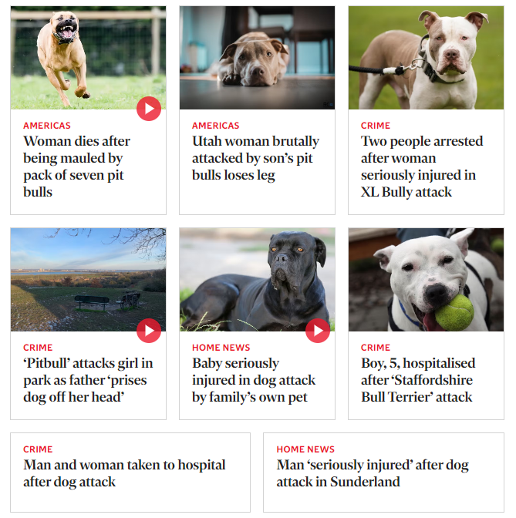
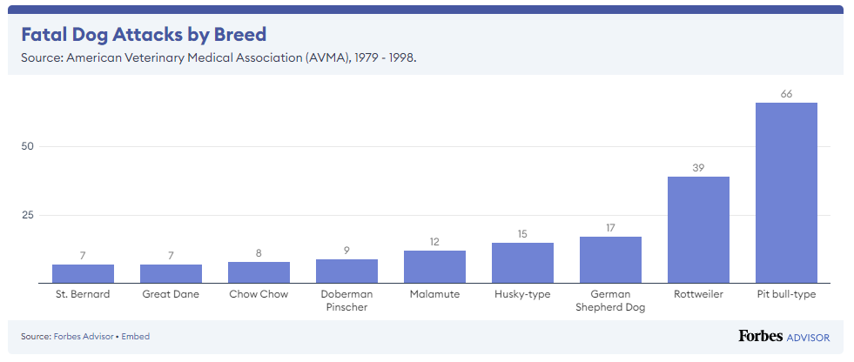
Project overview
DOGS BITING: POTENTIAL RISK AROUND YOU
Every year, an estimated 4.5 million people are bitten by dogs in the United States.
15.55% of dog bites were committed by stray dogs rather than pets.

Slide 6
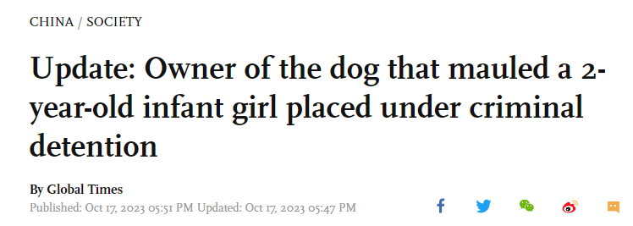
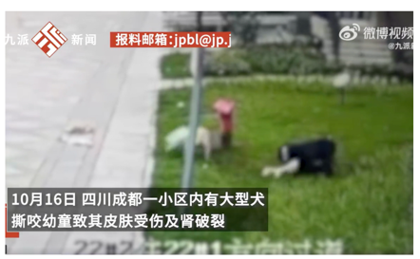
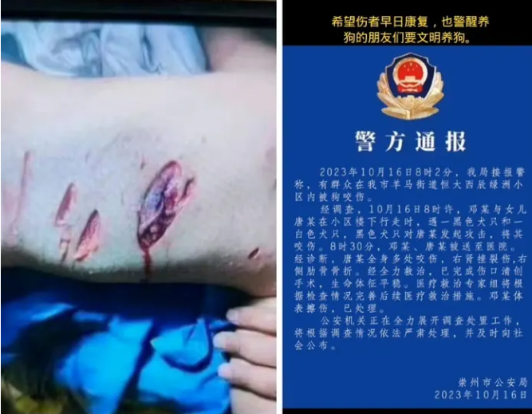
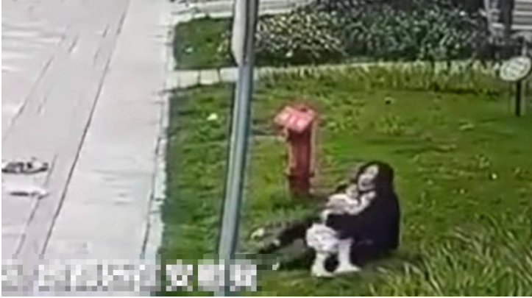
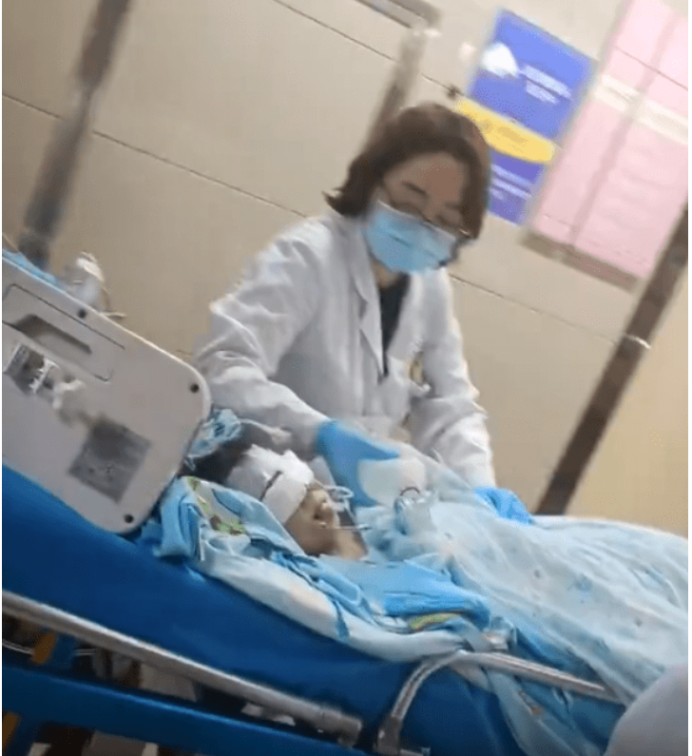
Project overview
IN CHINA: SOCIAL REFLECTIONS BROUGHT BY A 2-YEAR-OLD GIRL AS VICTIM OF DOG BITING
CHINA DOGS MANAGEMENT STATUS
PUBLIC
BASIC KNOWLEDGE
GOVERMENT
LOCAL LEGALS
DOGS
TRAINING COURSES

Slide 7
Project overview
What?
A system that offers a quick and simple classification tool for breeds of the dogs.
Why?
Dog owners sometimes know little for the breed of their dogs
Quick warning for the danger breeds
Whom?
Dog owners who want more information.
Anyone who finds a dog nearby and worries about the potential risk of biting.
Chinese police and community staff that is responsible for managing dogs

Slide 8
DATA COLLECTION & Augmentation
Haoyue Zhu
Jian Jiang

Slide 9
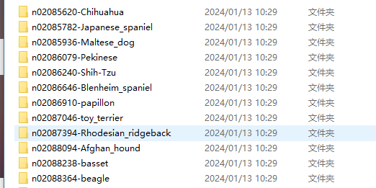
Data collection
Original Dataset: Stanford Dogs Dataset
Images of 120 breeds of dogs from around the world.
Number of categories: 120
~150 images per class
Total images: 20,580
Annotations: Class labels, Bounding boxes

Slide 10
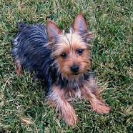
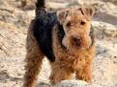
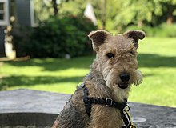

Data collection
Australian Terrier
Airedale Terrier
Lakeland Terrier
· Problems:
Small datasets, large amount of classes (~150/breed -> 120 classes ).
Few extra features except images themselves
High similarities in the apperance of some breeds
Computing resources limit with hundreds of thousands of images
· Solutions?
Process data augmentation to get more samples.
Use Image Batch Processor in MATLAB for processing multiple images simultaneously.
Add more features such as age and weight to improve dataset (in the future)

Slide 11
Data Augmentation
· Why?
Data augmentation can improve the generalization and robustness of the deep learning model.
· How?
We can apply various transformations to the existing images.
Rotation, Flip, Contrast Adjustment, Color Jittering, Gaussian Noise, Sharpen...

Slide 12
Data Augmentation
Functions decided to use:
· Grayed: Focus the model on variations in intensity rather than color.
· Flip/Mirrored: Become robust to position variations.
· Blurred: Removing noise and details of the images
· Gaussian: Become robust to noise.
· Sharpened: Enhancing the fine details and edges in an image.
Augmented dataset:
20K*6 = 120K images for training!

Slide 13
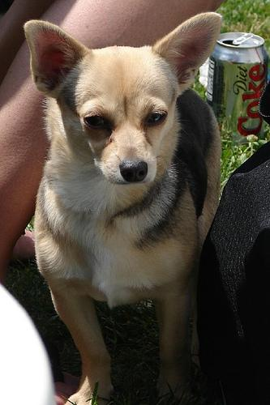
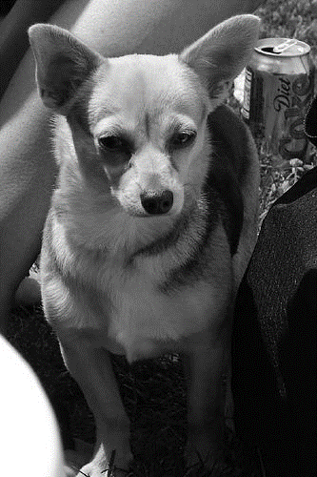
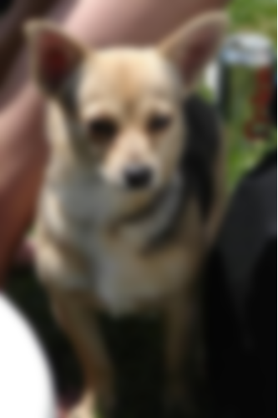
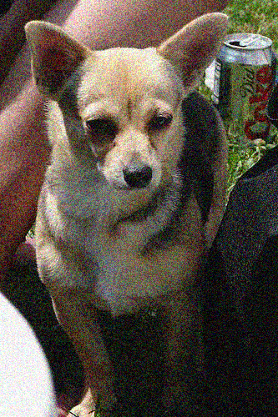
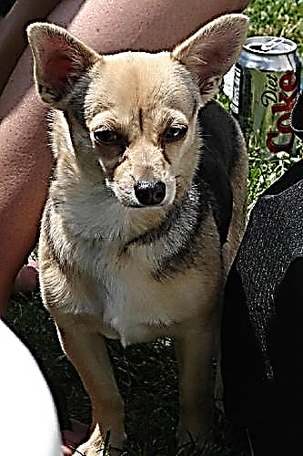
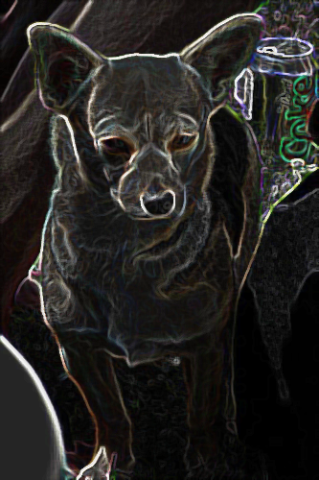

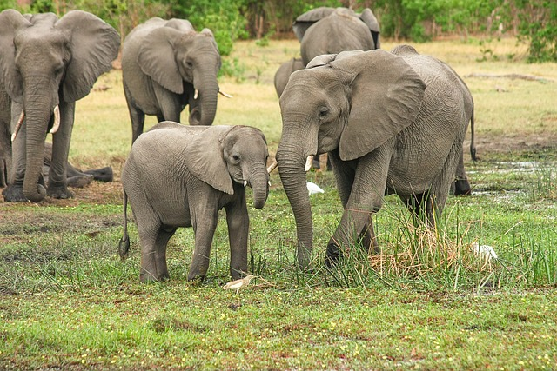
Data Augmentation
ID - Dataset
…
…
Original
Grayed
Blurred
Gaussian
Sharpened
OOD - Dataset
…
Due to computing resource we own, the scale of dataset is limited.

Slide 14
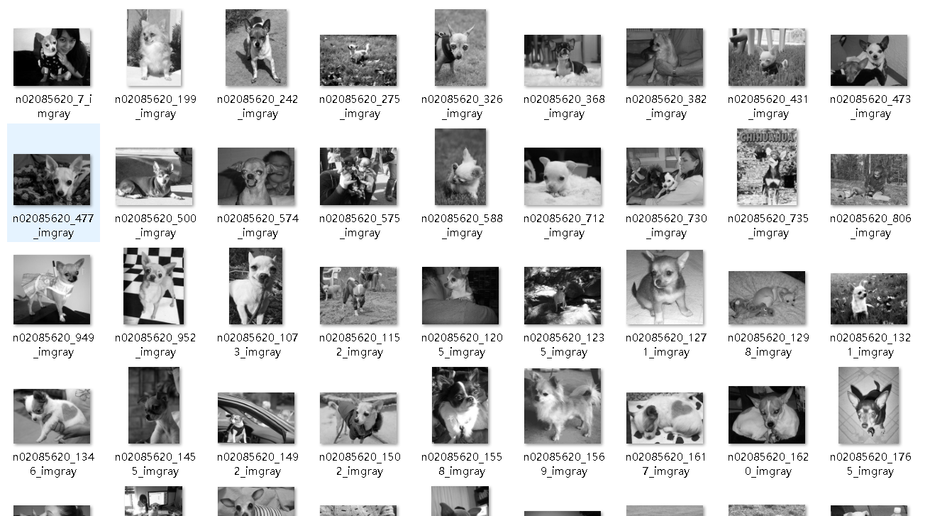
Data Augmentation
Example:
Grayed dataset

Slide 15
Model training & evaluation
Keren Zhou
Ruize Xia

Slide 16
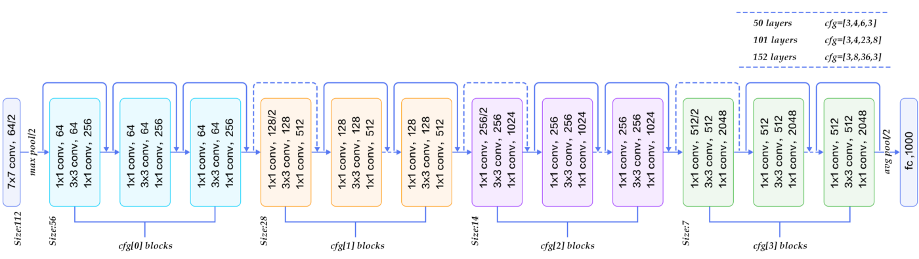
What is resnet
Short for Residual Networks, is a classical convolutional CNN architecture for deep learning.
Composed of residual blocks. Each block contains a shortcut connection that skips one or more layers.

Slide 17
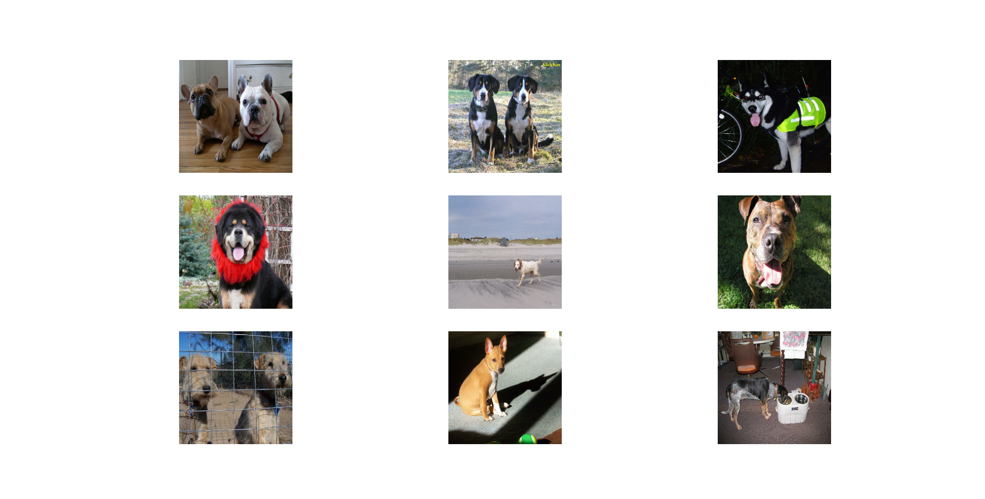
Why Resnet50
Addressing Gradient Issues
Deeper Networks
Alleviating Degradation Issues
Efficient Model Training
Transfer Learning

Slide 18
Work flow
Building a Model
Visualizing The Metrics Curves
Fetching Data
Training
Prediction

Slide 19
Building a Model
Rescaling Layer
Pre-trained Model
Dropout Layer
Dense Layer
Adam Optimizer
Loss

Slide 20
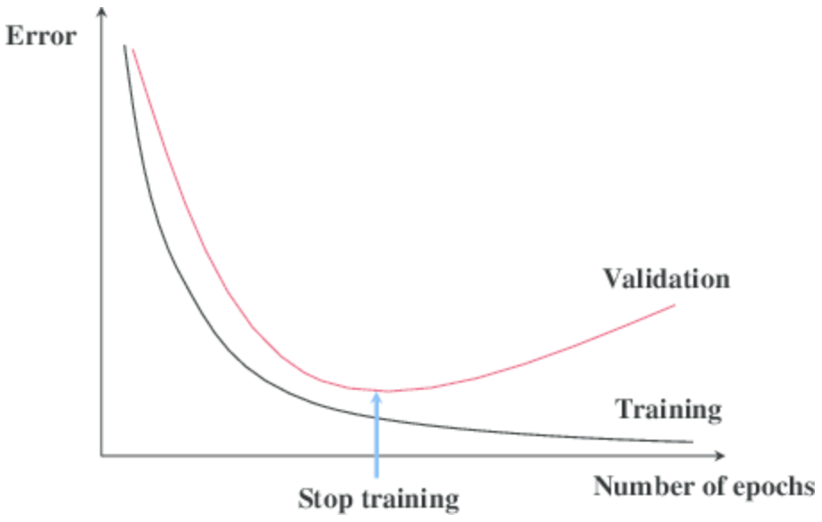
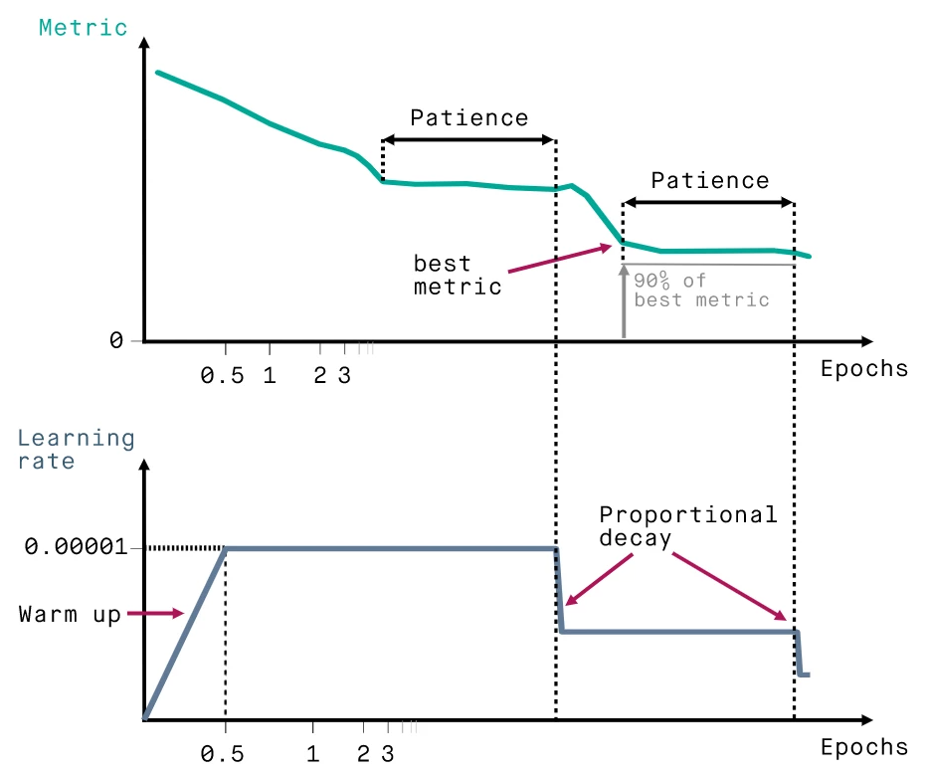
TRAINING
Callbacks:
ModelCheckpoint: This callback saves the model weights after every epoch if the validation loss improves.
EarlyStopping: This callback stops the training process if the validation loss doesn't improve for a certain number of epochs.
ReduceLROnPlateu: This callback monitors a quantity and if no improvement is seen for a 'patience' number of epochs, the learning rate is reduced.
Early Stopping
Reduce Learning Rate

Slide 21
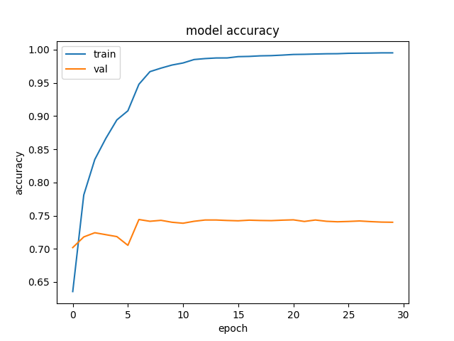
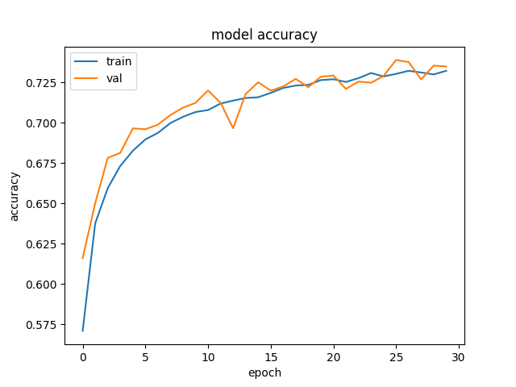
Visualizing The Metrics Curves
After the cross-validation, we can see……
Without Data Augmentation
With Data Augmentation
Epochs: 30
Batches: 32
Optimizer: Adam with learning rate of 1e-4
After augmentation Multi-class balanced accuracy: 0.732 (train) / 0.734 (validation)

Slide 22
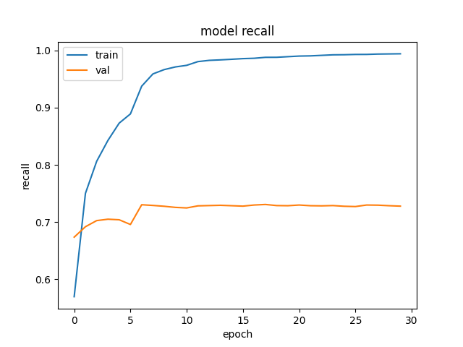

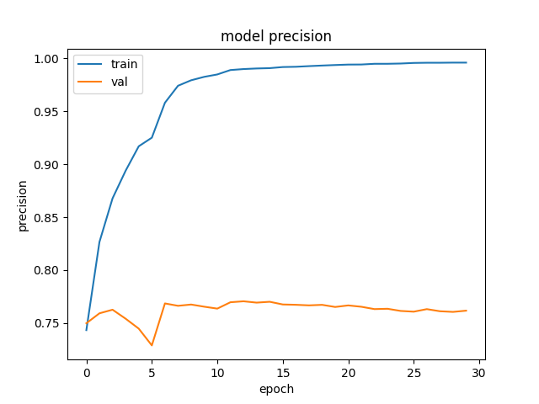
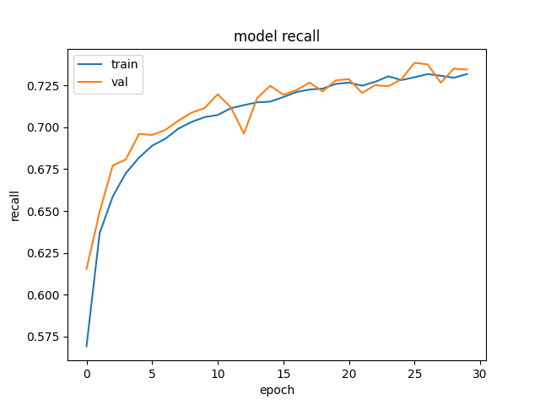
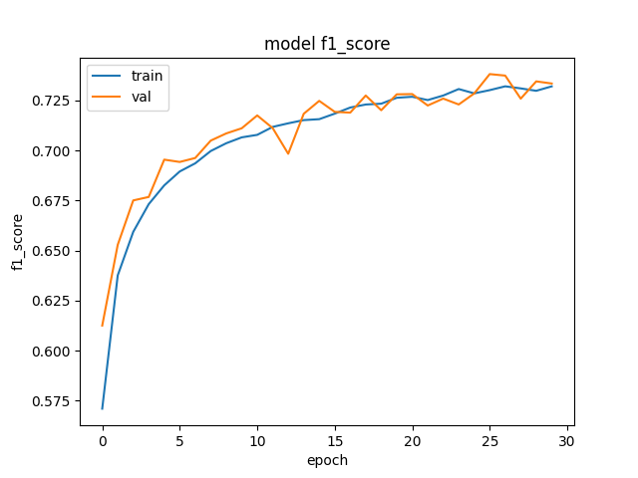

Visualizing The Metrics Curves
Without Data Augmentation
With Data Augmentation

Slide 23
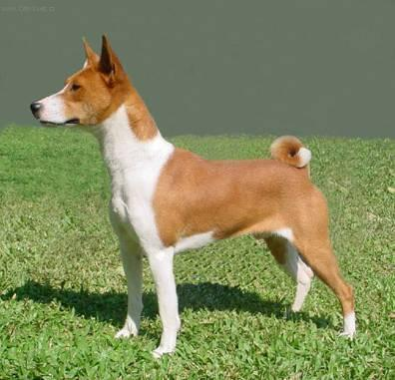
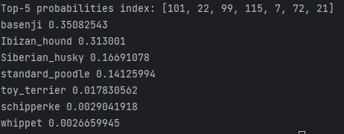
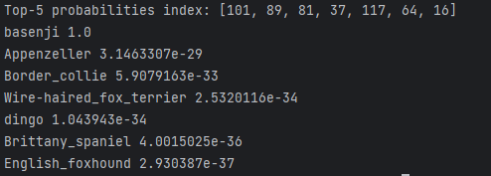
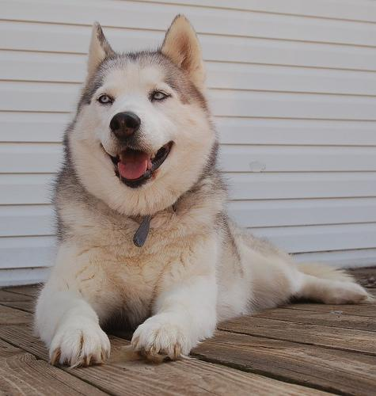
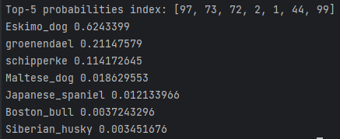
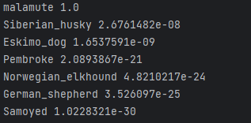
Prediction
Probabilities 0.35 followed by 0.31 is not convincing!
Perfectly predicted!
True Label: Basenji
Model Without Data Augmentation
Model With Data Augmentation
Correct, but 0.62 may not be believable enough!
True Label: Eskimo Dog
Model Without Data Augmentation
Model With Data Augmentation
Also make some mistakes sometimes?

Slide 24
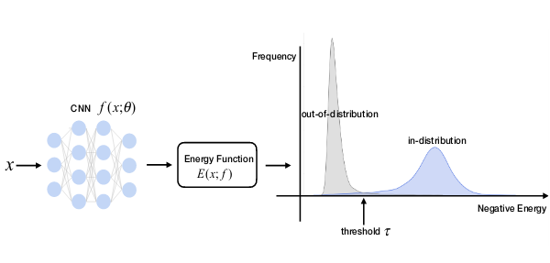
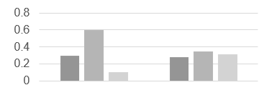
Prediction
How to determine whether the probability is convincing enough?
How to determine the object belongs to the dataset (OOD Detection)?
Thresholds?
True Label: Eskimo Dog
Model Without Data Augmentation
ID - Dataset
OOD - Dataset
Energy
Max Softmax Probability

Slide 25
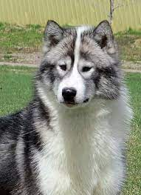
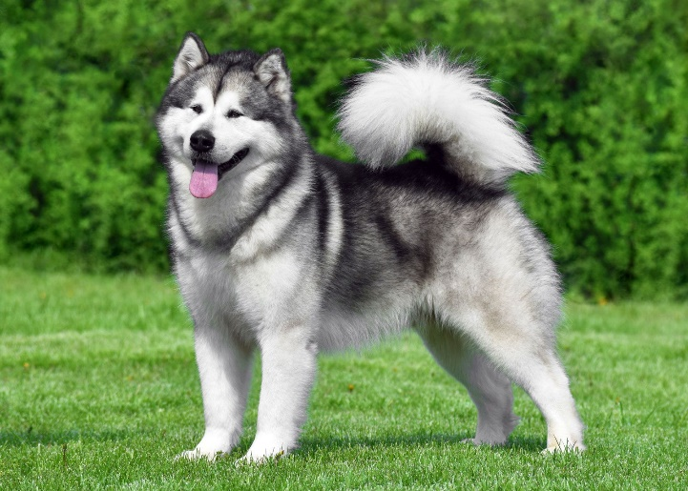
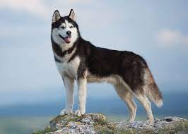
Prediction
Mistakes?
Canadian Eskimo Dog
Alaskan Malamute
Siberian Husky
Need more features!
Even difficult for human experts sometimes!

Slide 26
User interface & project implementation
Xiaoyan Xue

Slide 27
Project structure
Tech stacks
DATABASE
BACK-END
FRONT-END
HTML5
CSS3
MATLAB
JAVA
Batch Processor
Swagger
Redis
JavaScript
SpringBoot
MyBatis
React
MYSQL
Node
Breed
Python
Umi
Record
Tensorflow
Numpy
Ant Design
Prediction
Matplotlib
Scikit-learn

Slide 28
Project structure
Data flow
DATABASE
BACK-END
FRONT-END
HTML5
CSS3
MYSQL
JAVA
2. MYSQL Query
Swagger
Redis
JavaScript
Breed
1. HTML Request
SpringBoot
MyBatis
React
Record
5. Predicted
Breed Information
6. Display
Information
Node
Prediction
Python
3. Invoke Python
Classifier
Umi
Tensorflow
Numpy
User
Ant Design
Matplotlib
Scikit-learn
4. Predicted
Breed Class
06.02.2024
28

Slide 29
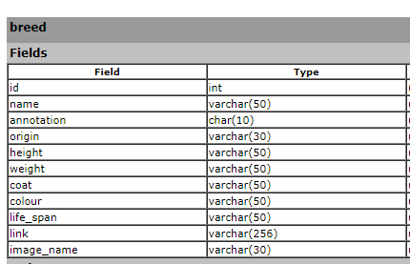
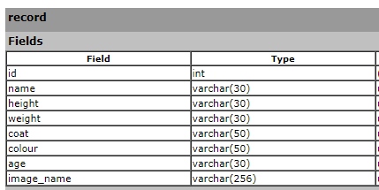
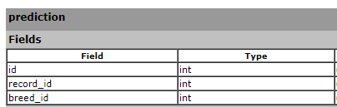
Project structure
database
Breed
Record
Prediction
Stored model prediction results
Connected with Breed and Record table with breed.id and record.id
Stored basic breed information
Can be added/updated with more dataset
Link for Wikipedia needs auto-checking regularly.
Stored record information which user inputs.

Slide 30
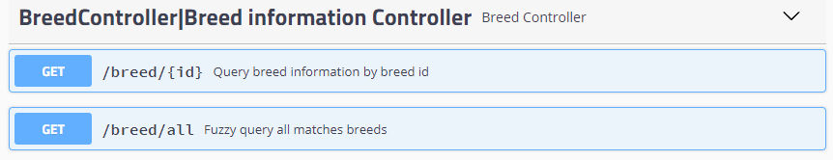
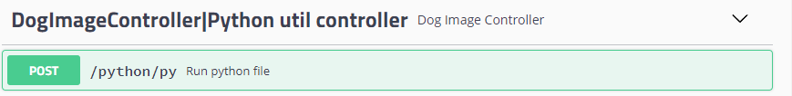
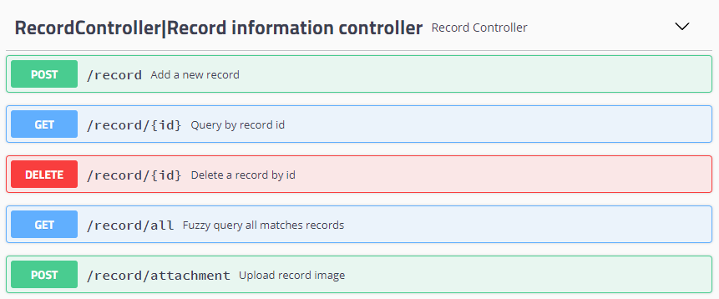
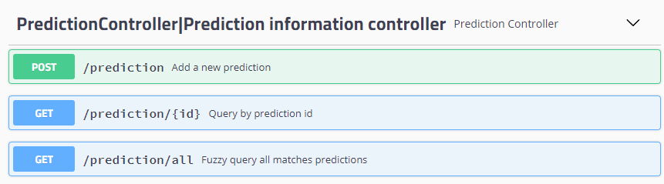
Project structure
BACKEND

Slide 31
UI display
frontEND
Demo display!

Slide 32
Related work

Slide 33
RELATED WORK
Data
Dataset: More high quality dataset for model training.
Augmentation: Use bounding box in the annotation to get position information more precisely.
Model
Training: More variety of models such as DenseNet, InceptionNet and ResNet-152, which can use majority voting.
UI
More user-friendly functionalities: archives, alarms, etc.
More platforms supported
Training: More Epochs, different hypermeters research such as MC dropout

Slide 34
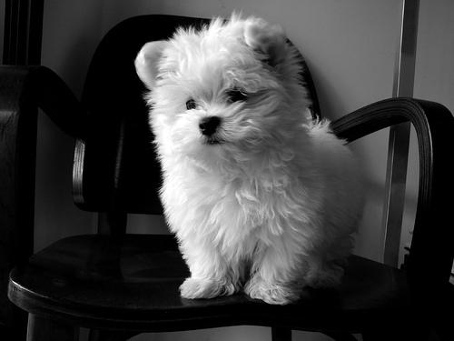
RELATED WORK
Bounding box
y_max
Data Augmentation: Use bounding box to get precise dog positions in the image.
It helps to identify the breed information and extract useful features for model training.
Randomly cropping to full backgrounds also can be prevented with the help of bounding boxes.
y_min
x_min
x_max

Slide 35
Thanks for watching!
Any questions?
DATA SCIENCE II / TU DARMSTADT
DeadLock

